Slide 1
Using the Knowledge Expression and Reasoning method to solve the problems in Formal Verification
Renyan Feng¹
Authors: Yisong Wang¹, Fangzhen Lin²
¹Guizhou University, P. R. China
²Hong Kong University, P. R. China

Slide 2
Overview
Motivation
CTL
Existing works
SNC and WSC in bounded CTL (accepted by KR 2020)
A Resolution-based method in CTL (submitted in AAAI 2021)
To do
Implement the Resolution-based method to compute the forgetting in CTL
Solve a problem in Verification with the above system
Schedule
Thanks

Slide 3
Motivation
Verification: The Weakest precondition (WP) and the Strongest Post-condition (SP), introduced by the Dutch computer scientist Edgar Dijkstra, have been fruitfully used for specification and verification of concurrent/ distributed systems.
KR: Forgetting has been wildly developed.
is an important method to compute the Weakest Sufficient Condition (WSC) and the Strongest Necessary Condition (SNC) in Propositional Logic (PL) and First-Order Logic (FOL), and
a technique to distill knowledge from a theory.

Slide 4
CTL
: transition relation : label function
S: a finite set of states
s₀: an initial state in S
Stands for Computation Tree Logic
Informally, CTL is interpreted over Kripke Structures
Let M = ( S, R, L, s₀) be an initial structure
We call (M,t) a K-structure (t∈S), and if t is an initial state, then (M,t) is an initial K-structure.
Consider this Kripke structure (labeling omitted) :
is a Kripke structure (S,R,L) with initial state s₀
the computation tree of 0 with depth 2:
M1 :
0
depth:1
0
depth:0
0
1
2
0
1
2
1
. . .

Slide 5
CTL
The path quantifiers :A and E
The temporal operators : X (neXt), F (Future), G (all future states (Globally)), U (Until)
ϕ ::= p // atomic (state) proposition (atom): | ¬ϕ | ϕ₁ ∧ ϕ₂ | EX ϕ | EG ϕ | E(ϕ₁ U ϕ₂)
(M,t) ⊨ ϕ ϕ holds on the sate t
Which is recursively defined as follows:
(M,t) ⊨ p iff p ∈ L(t)
(M,t) ⊨ ¬ϕ iff not ( (M,t) ⊨ ϕ )
(M,t) ⊨ ϕ∧ψ iff (M,t) ⊨ ϕ and (M,t) ⊨ ψ
Notes:
M would only have one computation tree if it only has 1x innitial states; else it can have multiple comp. trees. Of course, each computation tree can be inifitely deep.

Slide 6
CTL
(M,t) ⊨ EXϕ iff ( ∃(t,v)∈ R such that (M,v) ⊨ ϕ )
(M,t) ⊨ EGϕ iff
There is a path σ=(t₀=t, t₁,...) in M, starting at t such that:
For all i≥0, (M, t_{i})⊨ ϕ
(M,t) ⊨ E[ ψ U ϕ ] iff There is a path σ=(t₀=t, t₁,...) in M, starting at t such that:
For some i≥0, (M, t_{i} )⊨ ϕ
For all previous j, 0≤j<i, (M, t_{j} )⊨ ψ
We say an initial K-structure (M,s₀) is a model of ϕ if (M, s₀) ⊨ ϕ.

Slide 7
SNC and WSC in bounded CTL (accepted by KR 2020)

Slide 8
Bounded CTL
The size of CTL formula is bounded to n.
It will be sufficient to consider the models of formulas within a state space S satisfying [1].
[1] Emerson, E. A., and Halpern, J. Y. 1985. Decision proce-dures and expressiveness in the temporal logic of branchingtime.Journal of computer and system sciences30(1):1–24.

Slide 9
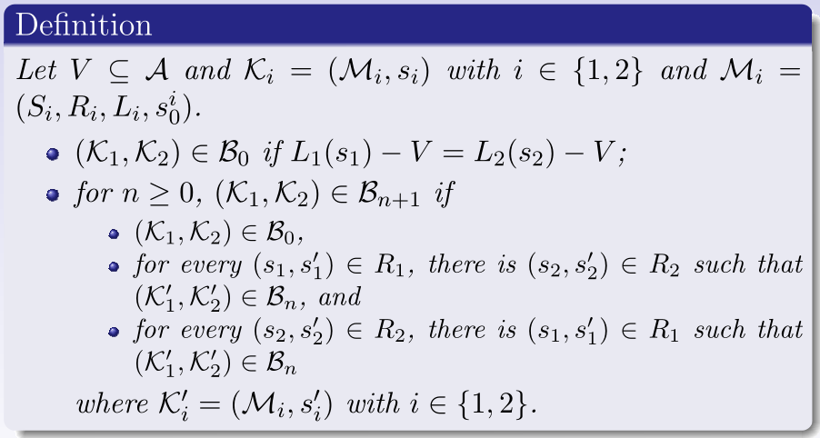
Set-based bisimulation
To introduce the V-bisimulation between two k-structures, the relations B₀, B₁, ..., are defined as follows.

Slide 10
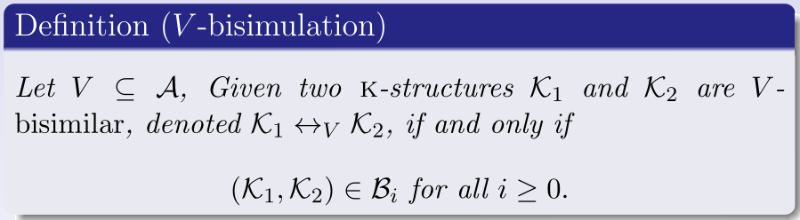
Set-based bisimulation
We use these V-bisimulation also for computation trees.

Slide 11
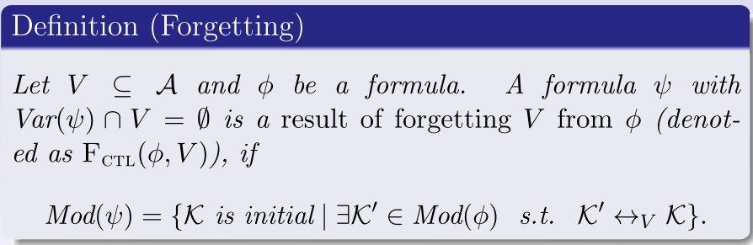
Forgetting
: the set of atoms appearing in .
: the set of models of .
Such a formula always exists in Bounded CTL.

Slide 12
SNC and WSC
Two important logical notions:
Strongest Necessary Condition (SNC) is the most general consequence；and
Weakest Sufficient Condition (WSC) is the most specific abduction
Note: SNC and WSC correspond to Weakest precondition (WP) and Strongest post-condition (SP) respectively, which introduced by the Dutch computer scientist Edgar Dijkstra.

Slide 13
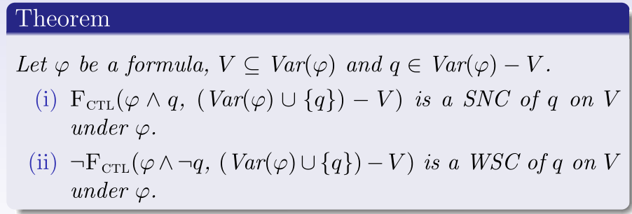
The relationship - SNC (WSC) and Forgetting
Dual
SNC
WSC

Slide 14
Contributions
A Forgetting framework for CTL
Representation Theorem
Complexity results
Algebraic Properties of the Forgetting operator: Homogeneity, Commutativity, and others
Computing SNC and WSC by using Forgetting in CTL

Slide 15
A Resolution-based method in CTL
“（submitted in AAAI 2021)”

Slide 16
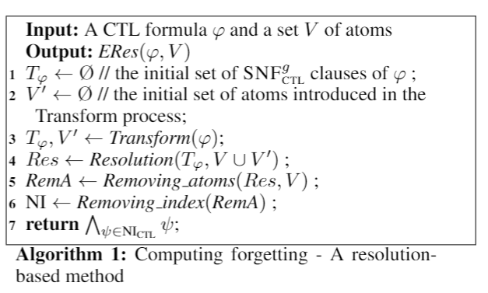
Algorithm
Extend the resolution method of Zhang at al.
new atoms

Slide 17
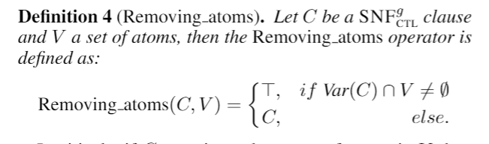
Eliminate atoms in V

Slide 18
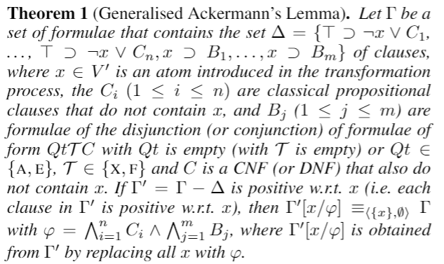
Generalised Ackermann's Lemma
To eliminate the new atoms introduced in the Transform process.

Slide 19
To do
Construct a system to compute the forgetting in CTL with Prolog
Solve some actual scenarios with our system.....

Slide 20
Schedule
Implement the Resolution-based algorithm by using the Prolog Language under SWI-prolog in 6 months.
In order to transform our ideas into reality and apply them in actual scenarios, we will look for representative Problems to use our system in 1 to 2 months.
Do some experiments to demonstrate the practicability of the method in 2 to 3 months.

Slide 21
Thanks!

